Slide 1
Comparison of control methods

Slide 2
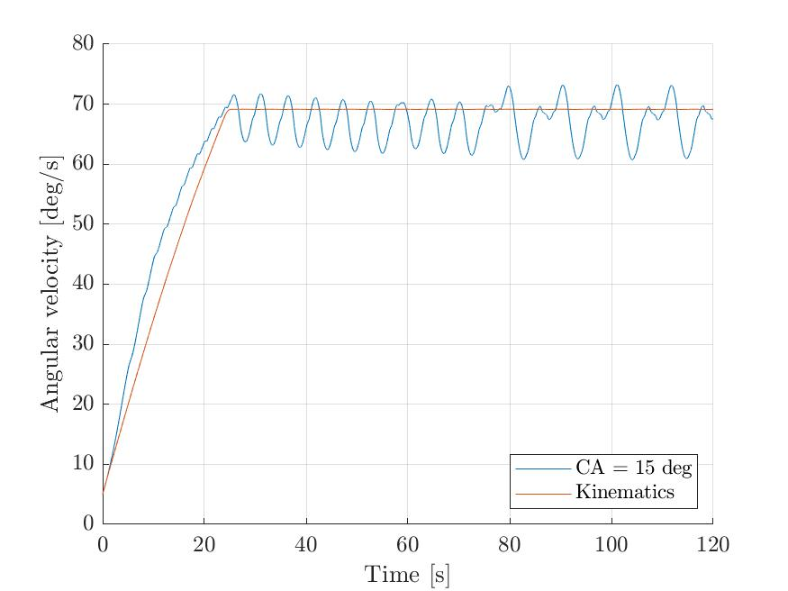
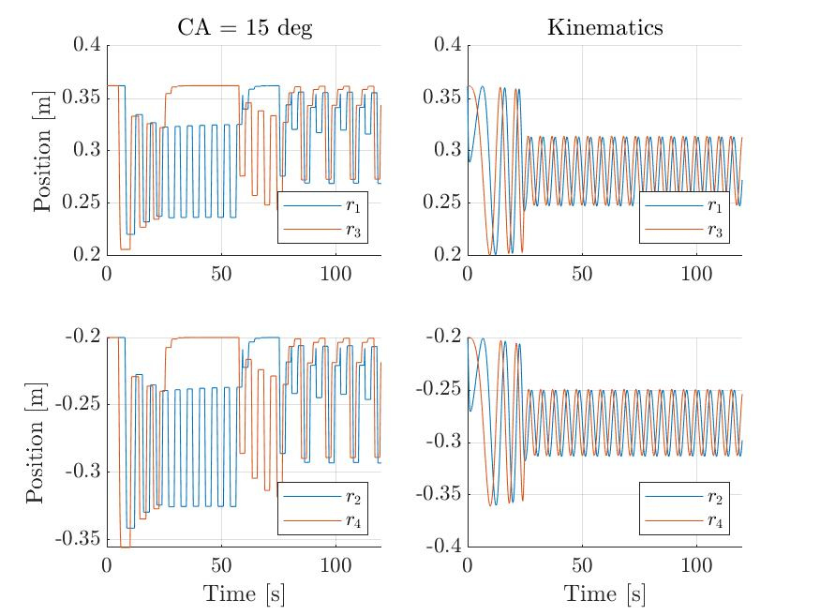
Set point 70 deg/s, Cone angle 15 deg

Slide 3
Work, power, and distance traveled

Slide 4
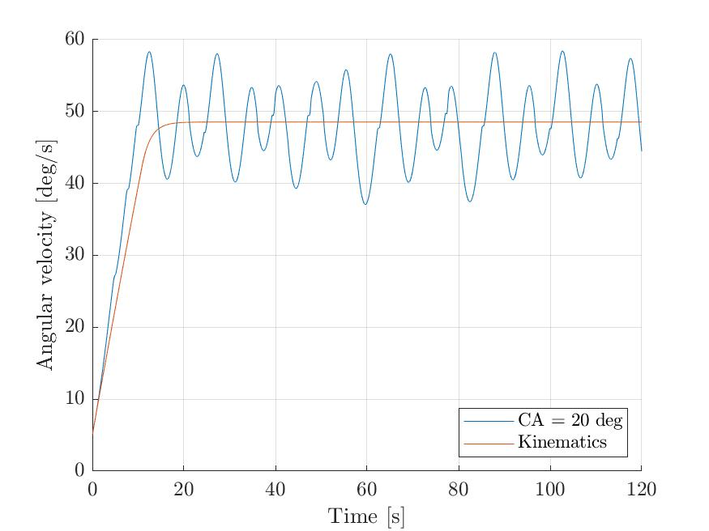
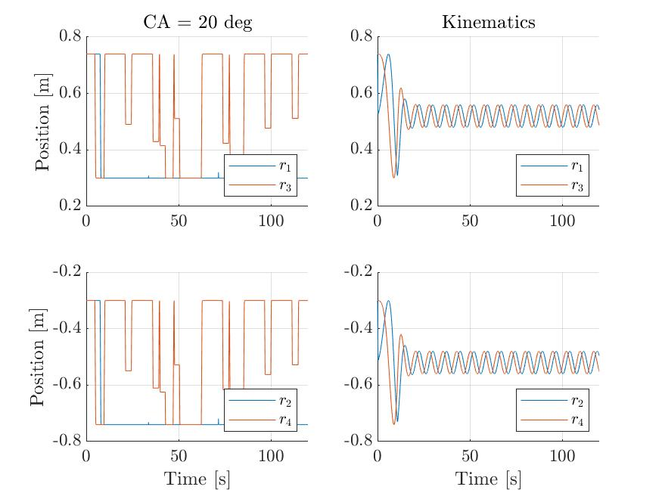
Set point 50 deg/s, Cone angle 20 deg

Slide 5
Work, power, and distance traveled

Slide 6
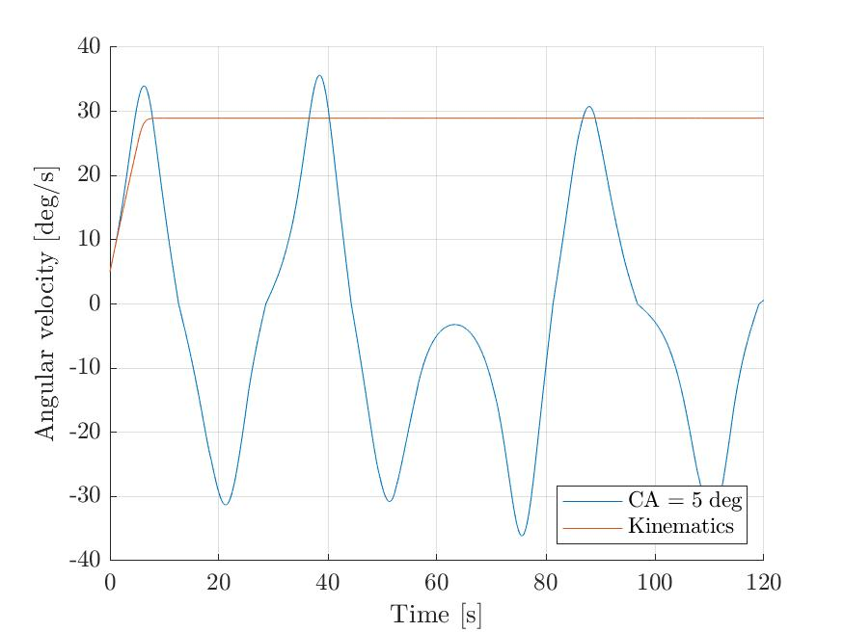
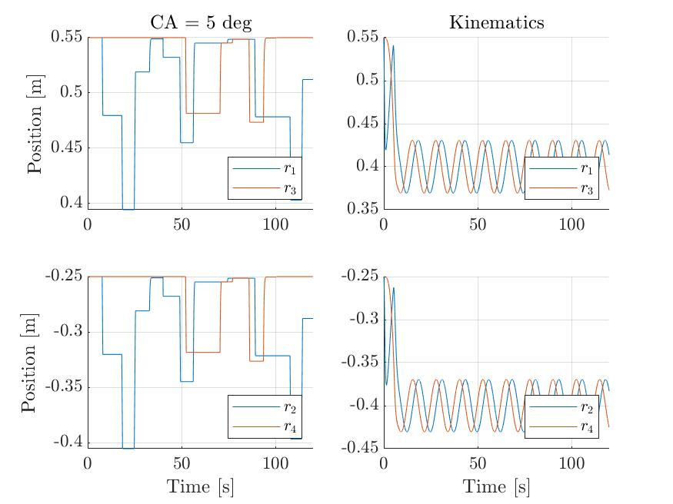
Set point 30 deg/s, Cone angle 5 deg

Slide 7
Work, power, and distance traveled

